Slide 1
DJANGO Model View Template

Slide 2
The MVT (Model View Template) is a software design pattern. It is a collection of three important components Model View and Template. The Model helps to handle database. It is a data access layer which handles the data.
The Template is a presentation layer which handles User Interface part completely. The View is used to execute the business logic and interact with a model to carry data and renders a template.
Although Django follows MVC pattern but maintains it’s own conventions. So, control is handled by the framework itself.
There is no separate controller and complete application is based on Model View and Template. That’s why it is called MVT application.

Slide 3
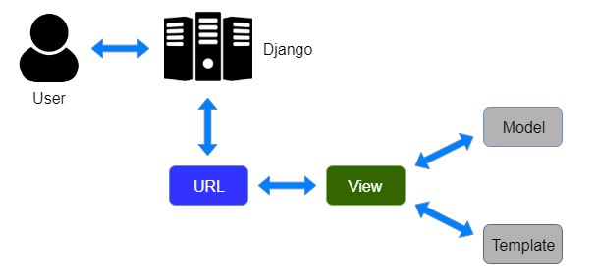
Figure showing Django’s MVT based control flow

Slide 4
From the figure above, a user requests for a resource to the Django, Django works as a controller and check to the available resource in URL.
Since Django is a web application framework, it gets user requests by URL locater and responds back. To handle URL, django.urls module is used by the framework.
If URL maps, a view is called that interact with model and template, it renders a template.
Django responds back to the user and sends a template as a response.

Slide 5
Django Model
In Django, a model is a class which is used to contain essential fields and methods. Each model class maps to a single table in the database.
Django Model is a subclass of django.db.models.Model and each field of the model class represents a database field (column).
Django provides us a database-abstraction API which allows us to create, retrieve, update and delete a record from the mapped table.
Model is defined in Models.py file. This file can contain multiple models.

Slide 6
Django Views
A view is a place where we put our business logic of the application. The view is a python function which is used to perform some business logic and return a response to the user. This response can be the HTML contents of a Web page, or a redirect, or a 404 error.
All the view function are created inside the views.py file of the Django app.

Slide 7
Django Templates
Django provides a convenient way to generate dynamic HTML pages by using its template system.
A template consists of static parts of the desired HTML output as well as some special syntax describing how dynamic content will be inserted.
Why Django Template?
In HTML file, we can't write python code because the code is only interpreted by python interpreter not the browser. We know that HTML is a static markup language, while Python is a dynamic programming language.
Django template engine is used to separate the design from the python code and allows us to build dynamic web pages.

